Slide 1
FLIGHT PRICE PREDICTION PROJECT PRESENTATION
Submitted by:
Mohini Singh (Data Science Intern at Flip Robo Technologies)

Slide 2
Business Requirement
INTRODUCTION

Slide 3
PROBLEM STATEMENT
The airline industry is considered as one of the most sophisticated industry in using complex pricing strategies. Nowadays, ticket prices can vary dynamically and significantly for the same flight, even for nearby seats. Anyone who has booked a flight ticket knows how unexpectedly the prices vary. The cheapest available ticket on a given flight gets more and less expensive over time. This usually happens as an attempt to maximize revenue based on
Time of purchase patterns (making sure last-minute purchases are expensive)
2. Keeping the flight as full as they want it (raising prices on a flight which is filling up in order to reduce sales and hold back inventory for those expensive last-minute expensive purchases)

Slide 4
PHASES OF THE PROJECT
This project is done in three parts:
- Data Collection
- Data Analysis
- Model Building
I created two different Jupyter Notebook files to performed the required actions.
As per the requirement of client, I have scrapped the data from online sites and based on that data I have performed analysis like based on which feature of my data does flight prices change and checked the relationship of flight prices with all the other features to get a gist on what flight a passenger should choose.

Slide 5
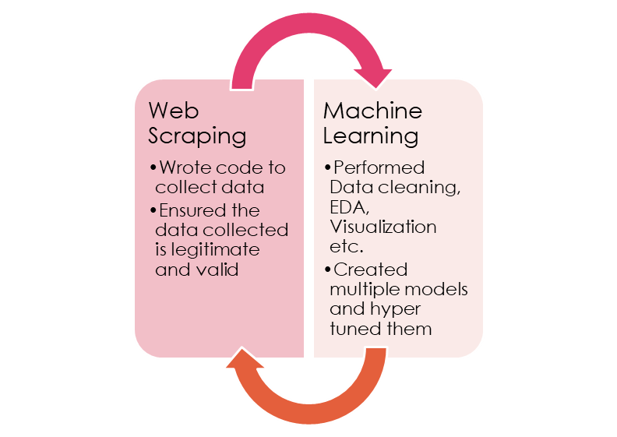
JUPYTER NOTEBOOK USAGE
Used the Python programming in Jupyter Notebook for 2 separate files
In the first notebook I wrote down the code to extract data for Flight prices and details from various web pages and stored them in a comma separated value file
Then the second notebook was created to make a Flight Price Prediction project and analyze various ways to get better predicted results

Slide 6
MODEL BUILDING STEPS
Data Cleaning
2. Exploratory Data Analysis
3. Data Pre-processing
4. Model Building
5. Model Evaluation
6. Selecting the best model

Slide 7
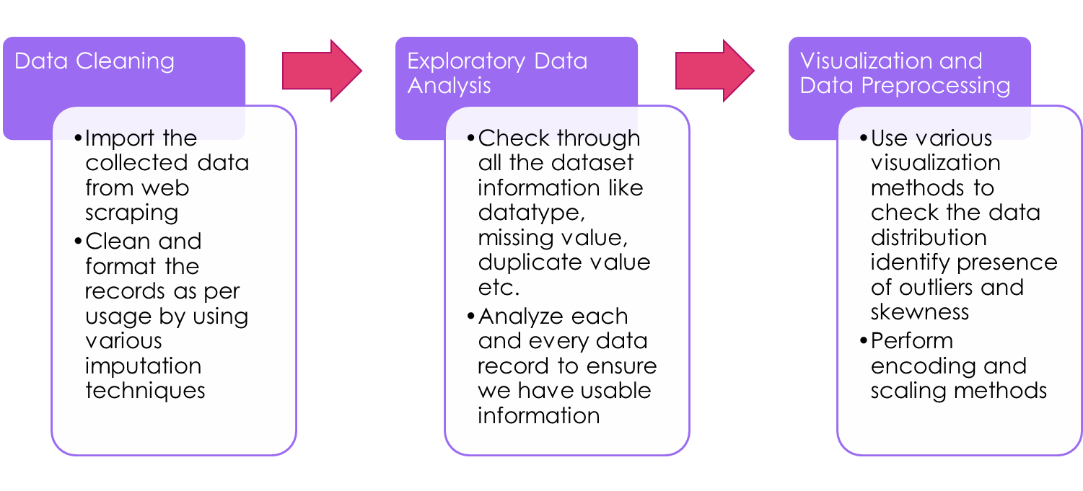
DATA SCIENCE LIFE CYCLE

Slide 8
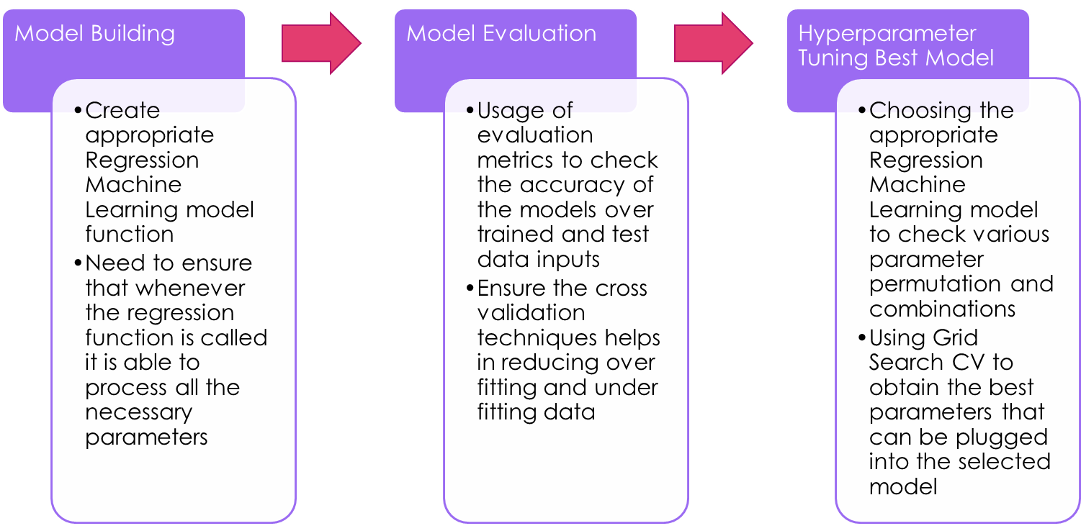
DATA SCIENCE LIFE CYCLE

Slide 9
WEB SCRAPING WEBPAGES FOR FLIGHTS

Slide 10
DATA PREPROCESSING
Importing the necessary dependencies and libraries.
Reading the CSV file and converted into data frame.
Checking the data dimensions for the original dataset.
Looking for null values and accordingly renaming the values.
Checking the summary of the dataset.
Checking unique values.
Checking all the categorical columns in the dataset.
Ensuring that the values are good to use and discarding junk data.

Slide 11
DATA PREPROCESSING
Visualizing with the use of pandas profiling feature.
Visualizing each features using matplotlib and seaborn.
Performing encoding using the ordinal encoder on categorical features.
Checking for co-relation/multi-collinearity in a heatmap.
Checking for Outliers/Skewness using boxen plot and distribution plot.
Checking for the final dimension of dataset to confirm the input details.
Creating train test split and the best random state found in the range 1-1000.
Taking a look at the importance of feature details to analyse further.

Slide 12
TECHNOLOGY USED
Hardware technology being used.
RAM : 8 GB
CPU : AMD Ryzen 5 3550H with Radeon Vega Mobile Gfx 2.10 GHz
GPU : AMD Radeon ™ Vega 8 Graphics and NVIDIA GeForce GTX 1650 Ti
Software technology being used.
Programming language : Python
Distribution : Anaconda Navigator
Browser based language shell : Jupyter Notebook
Libraries/Packages specifically being used.
Pandas, NumPy, matplotlib, seaborn, scikit-learn, pandas-profiling, missingno

Slide 13
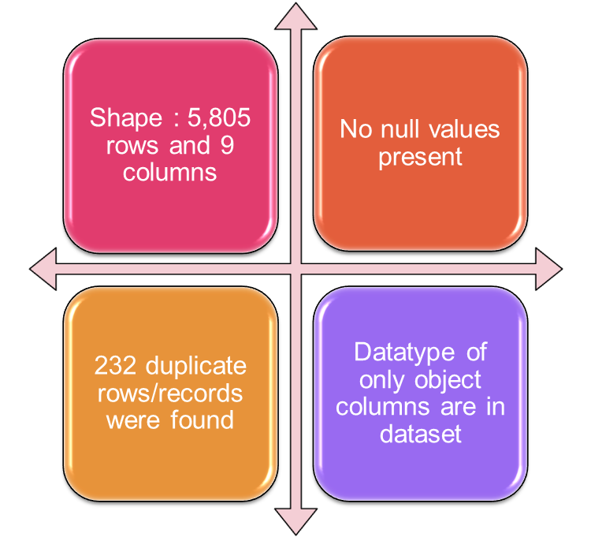
EXPLORATORY DATA ANALYSIS (EDA
First I have imported the necessary libraries and loaded the entire dataset in our Jupyter Notebook and renamed the project file from untitled.
Then I checked the shape of our dataset and found that we have a total of 5,805 rows and 9 different columns.
We don’t have any null values or missing values present in our dataset from the web scraping.
There were 232 duplicate rows/records in our dataset but I decided to retain them instead of deleting it.
By checking the data types I came to know that our data set consists of columns having only object datatype even those there were numeric information present.

Slide 14
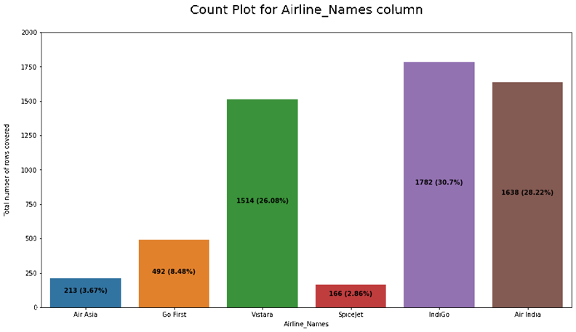
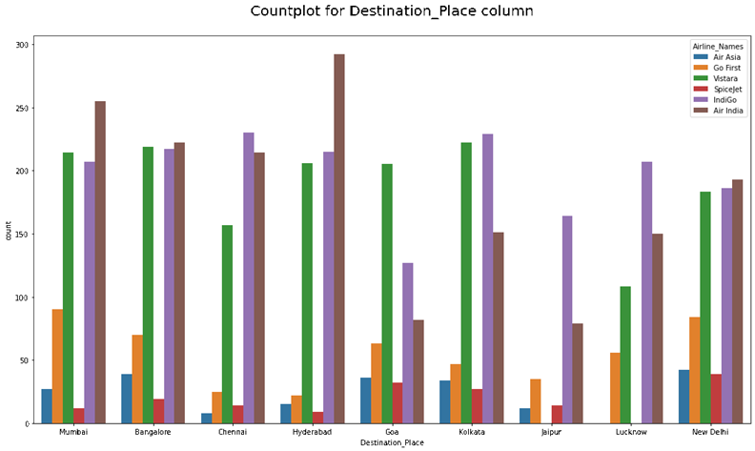
COUNT PLOTS

Slide 15
BAR PLOTS

Slide 16
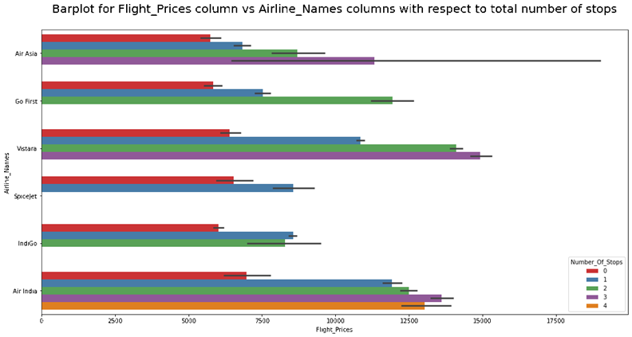
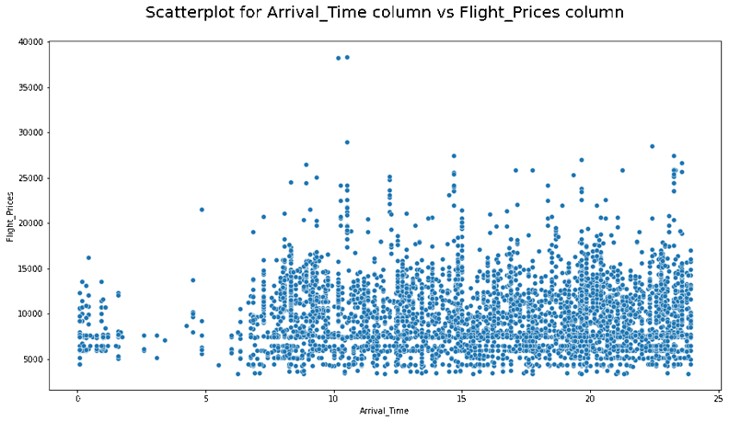
BAR PLOTS AND SCATTER PLOTS

Slide 17
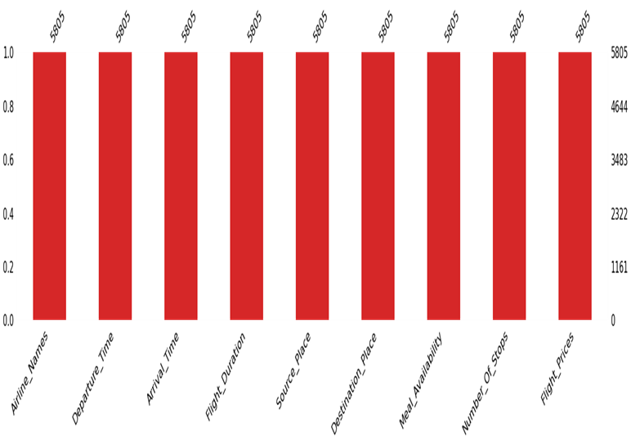
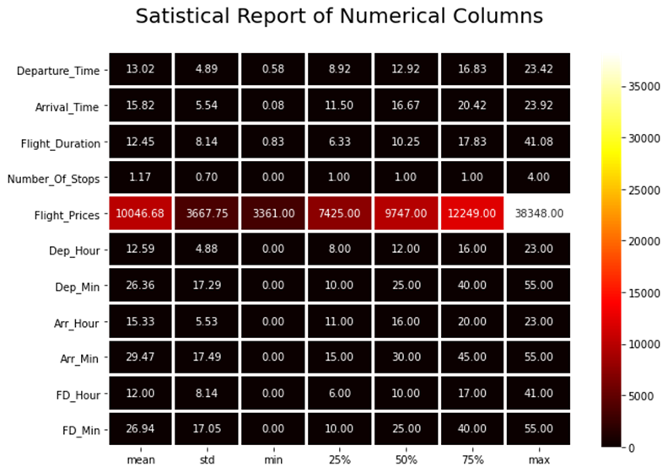
MISSING VALUES AND DESCRIBE DATA

Slide 18
THANK YOU

